Slide 1









Seaborn Video Game Sales Analysis
November 3, 2025
Kenneth Bathelemy
OIM 7502 Fall 2025

Slide 2



Agenda
Introduction to Project
Dataset Summary
Why Seaborn for Visualization
Platforms: Volume and Sales
Platforms: Release Trends
Publishers: Top Publishers by Count
Score Insights
Critic and User Score Correlations
Best-Selling Games Analysis
Conclusion and Takeaways

Slide 3
Introduction
Introduction
Project centers on Kaggle’s Video Game Sales dataset, containing units shipped, platform, publisher, critic and user score data.
Primary goal is to use Seaborn to uncover trends and relationships within the data through clear visualizations.
Focus areas include analysis of platforms, publishers, user and critic scores, and shipment volumes.
Seaborn chosen to create visualizations for data science purposes
Some comparison made between Seaborn’s straightforward syntax and Matplotlib’s more detailed customization options.

Slide 4
Dataset Summary
Dataset
Dataset Overview and Key Variables
Data Cleaning and Limitations
Approximately 19,000 records total in the dataset
Around 10,000 rows with Critic Scores available
Around 2,000 entries have valid user and critic scores
Key variables include Title, Platform, Publisher, Developed, Critic/User Score, Total_Shipped, Year
Removed missing values to ensure meaningful visualizations with User and Critic Scores
Total_Shipped mainly reflects physical shipments
Missing digital sales data limits full sales analysis
Data cleaning focused on reliability and clarity of visuals
Data available from 1977 to 2020

Slide 5




Why Seaborn?
Plus tip:
Highlight specific examples of Seaborn plots your audience would find useful for their data analysis projects.
Seaborn
Seaborn Advantages
Library intended for data visualization allowing for comparisons between several data variables
Handles multi-category visualizations like stacked distributions
Common plot types: countplot, barplot, displot, histplot, scatterplot, heatmap.
Seaborn and Matplotlib Integration
Built on Matplotlib, allowing advanced fine-tuning of plots
Matplotlib used primarily for customizing legends and annotations
Combines Seaborn's ease with Matplotlib's flexibility
Ideal for quick exploration and detailed presentation-ready visuals

Slide 6
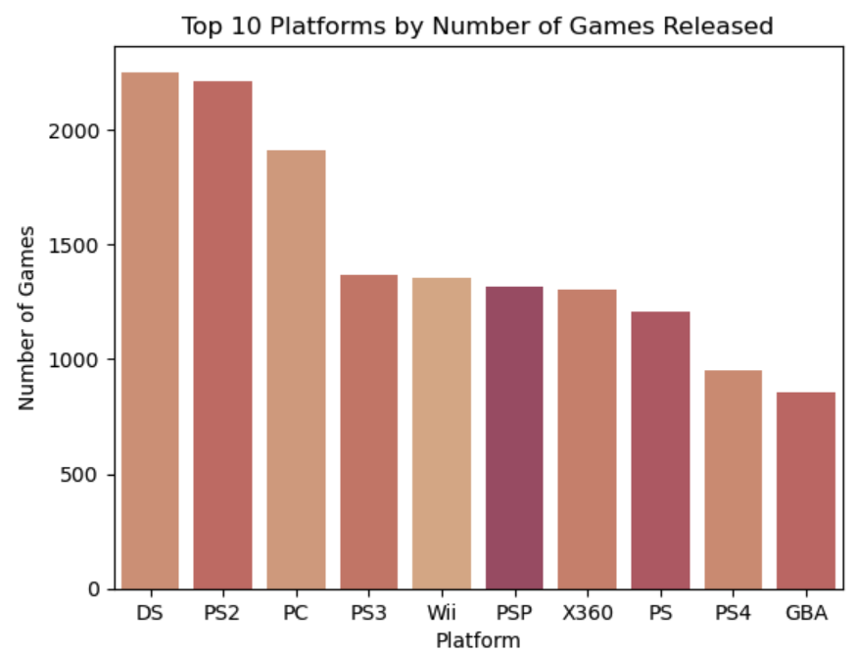
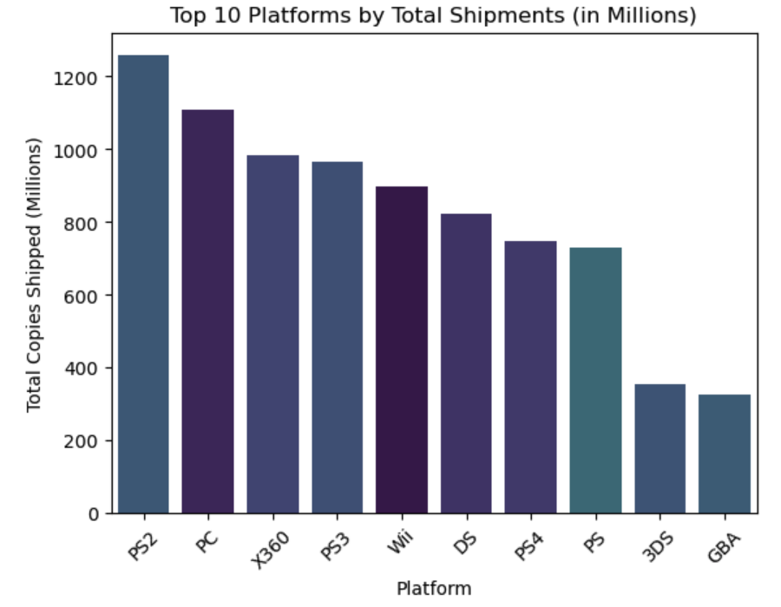
Volume & Sales
Plus tip:
Customize by adding recent platform sales data to show market trends over time.
Platforms
Top Platforms by Game Count
Top Platforms by Total Shipments
DS and PS2 have the highest number of game titles released.
These platforms dominate the volume metric in the dataset.
High title count indicates platform popularity and developer focus.
PS2 leads in total game units shipped, followed by PC and Xbox 360.
Shipment volume reflects commercial success beyond just game quantity.
Highlights platforms with strong market penetration and sales performance.

Slide 7

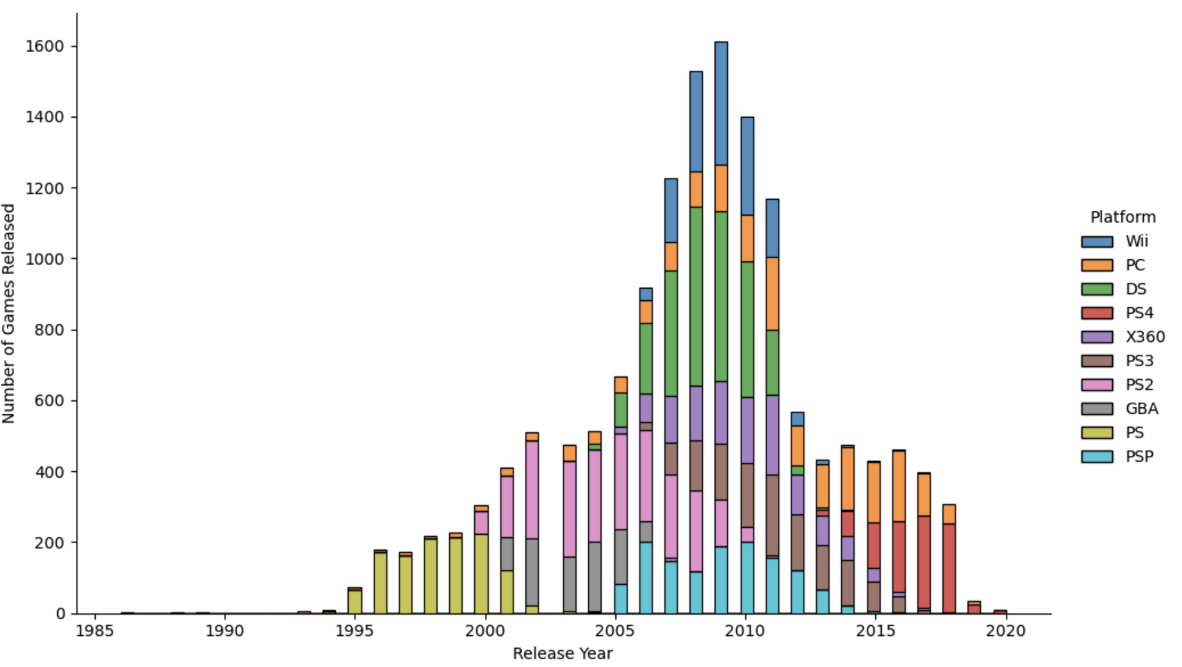
Release Trends
Plus tip:
Customize this slide by including specific platform names or trends relevant to your audience for greater impact.
Platforms
Platform Release Trends
Initial plot including all platforms was cluttered and hard to interpret
Filtered dataset to only the Top 10 platforms for clearer focus and better readability
Utilized Seaborn’s displot function, which provides automatic layering and smooth density estimation
Applied the 'tab10' color palette ensuring consistent, color-coded mapping in the legend for easy platform identification

Slide 8
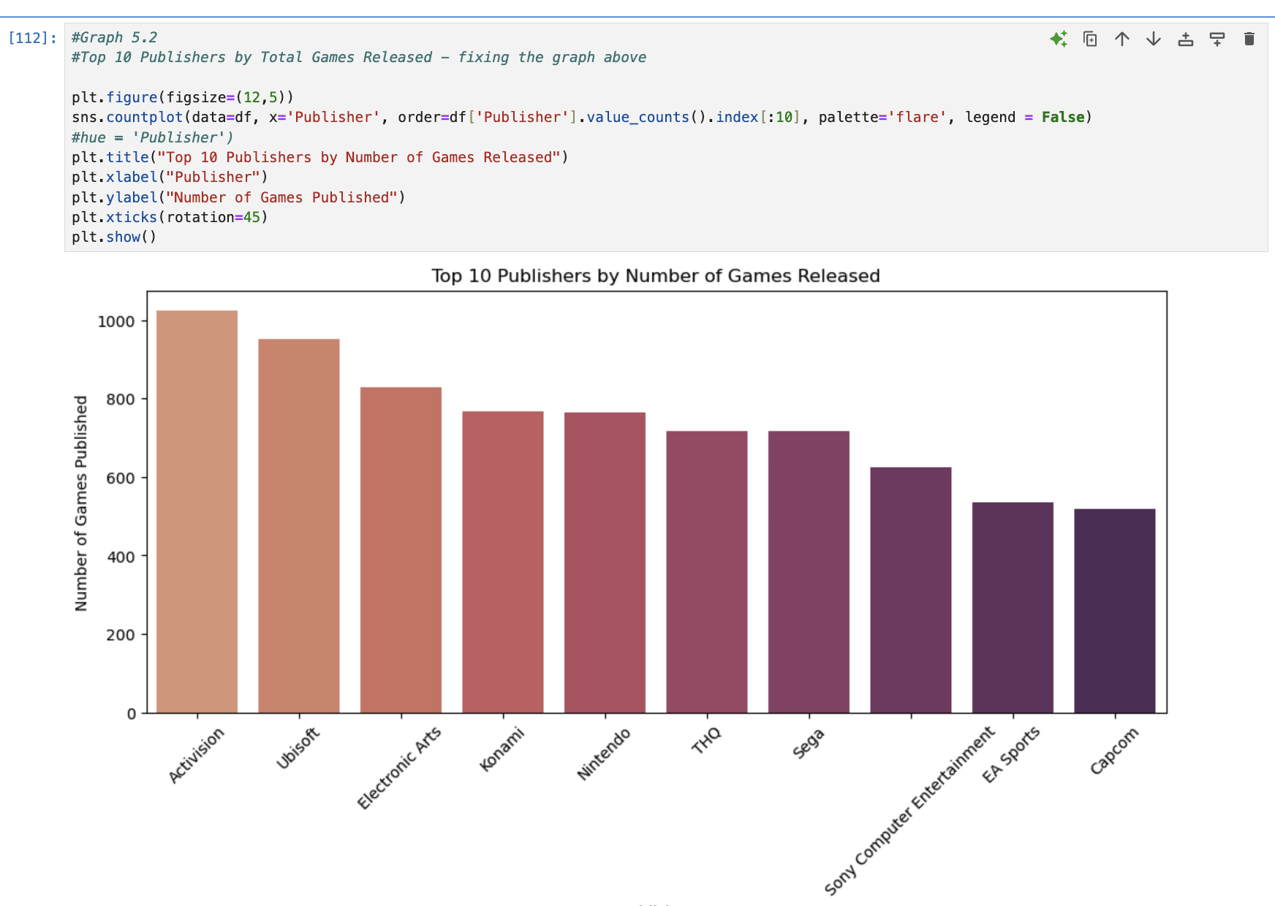
Publishers
Top Publishers by Count
Activision, EA, and Ubisoft are the most prolific publishers by game count.
These publishers dominate release volume across multiple gaming platforms.
High output reflects strong market presence and production capacity.
Barplots effectively highlight differences in publisher activity.
Plus tip:
Customize by adding recent publisher data or regional performance insights to increase relevance.

Slide 9
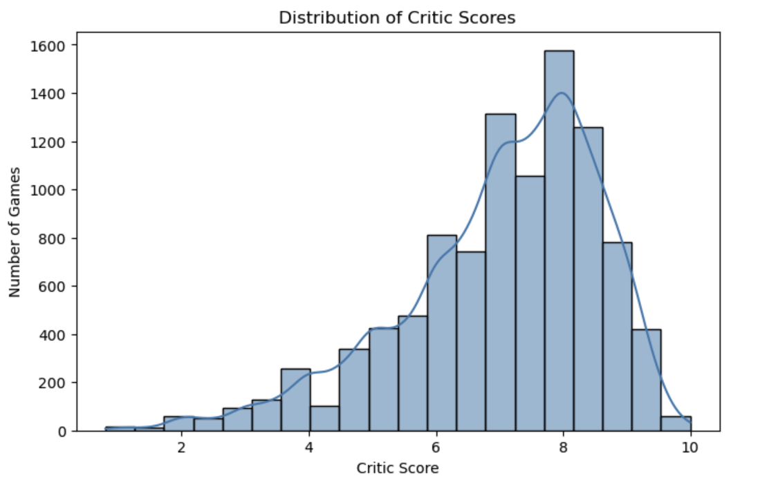
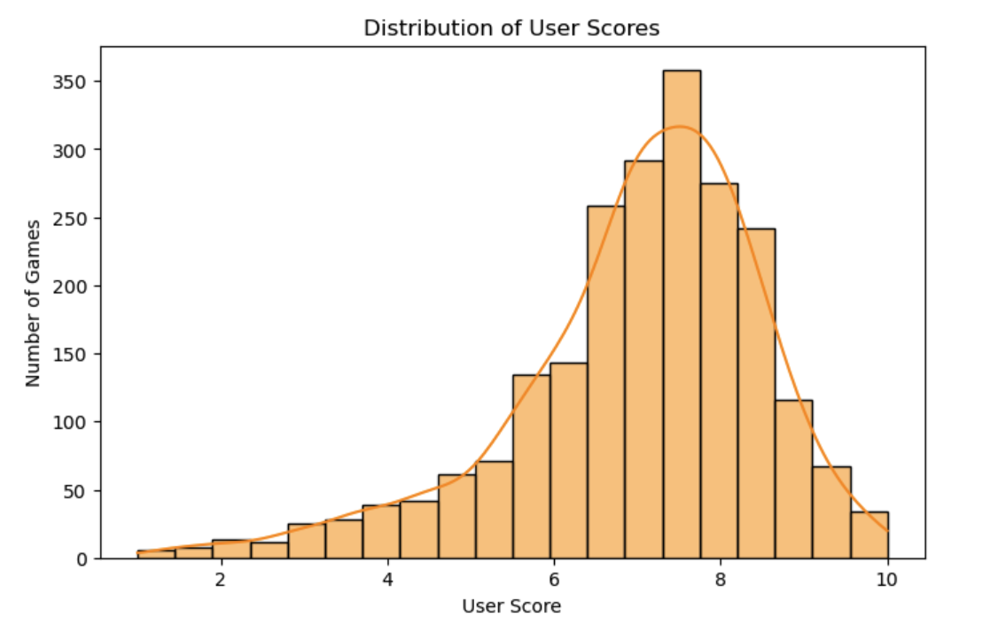
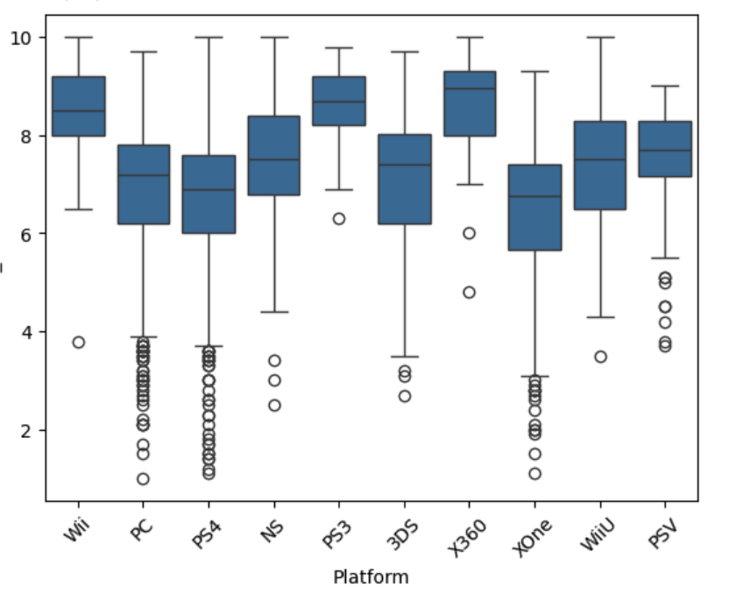
Score Insights
Analysis
Critic Score Distribution
User Score Variability
Boxplot by Platform
Critic scores form a bell-shaped curve centered near 8, indicating consistent critical reception.
User scores show greater variability and a lower average than critics, reflecting diverse player opinions.
Boxplots display median, interquartile range, whiskers, and outliers; PC platform shows the widest score range.

Slide 10

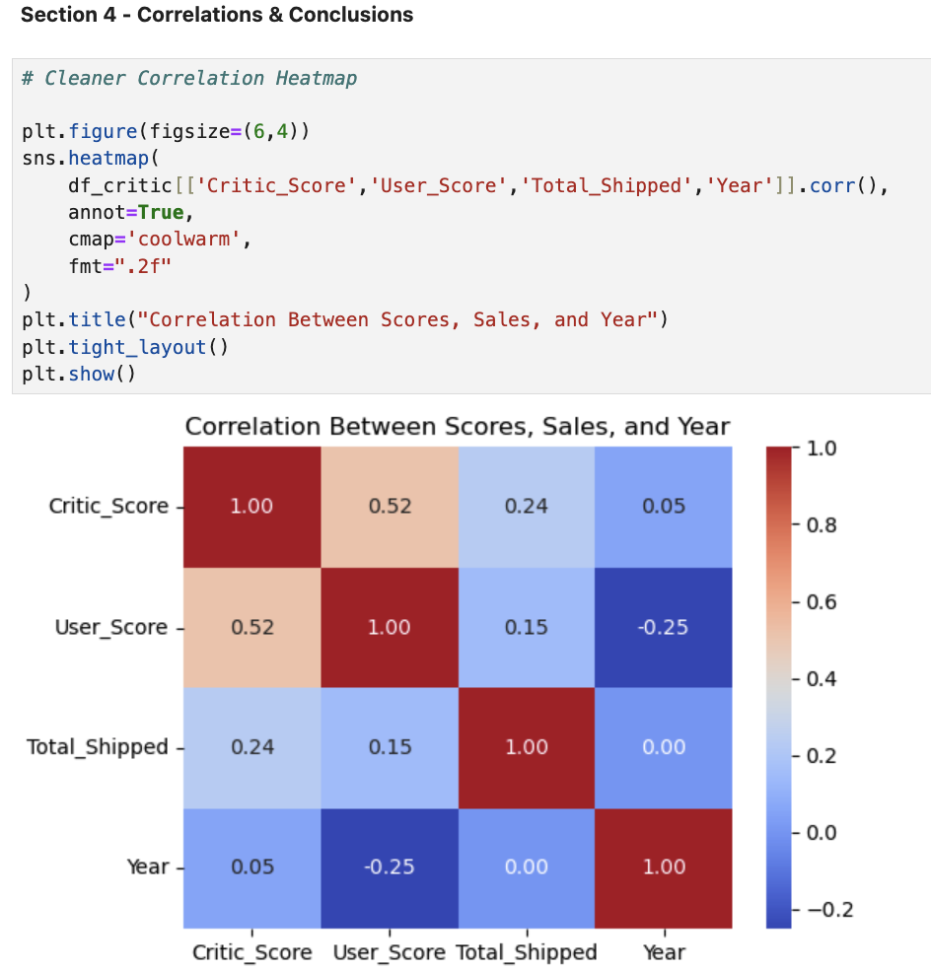

Analysis
Critic and User Score Correlations
Critic scores have a weak positive relationship with total shipments, while user scores show an even weaker correlation, indicating ratings are not strong predictors of sales.
Correlation Heatmap Insights
A correlation heatmap visually confirms the low correlation between critic/user scores and shipments, demonstrating Seaborn's strength in revealing data relationships.
Plus tip:
Customize the scatterplots by adding trend lines or highlighting specific game genres to make the correlations more engaging for your audience.

Slide 11

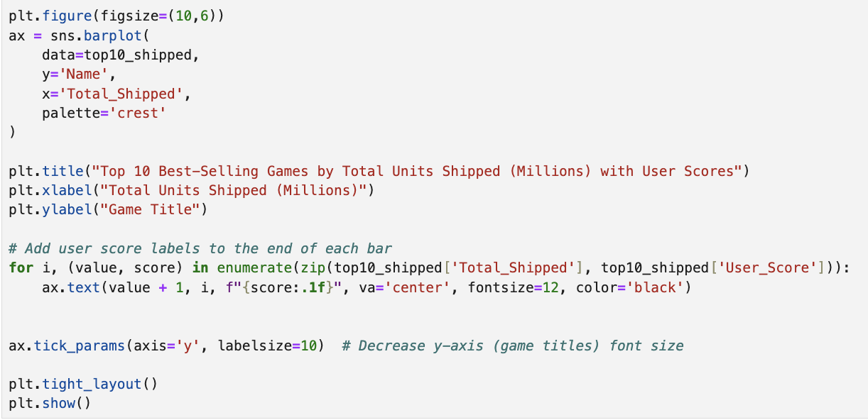

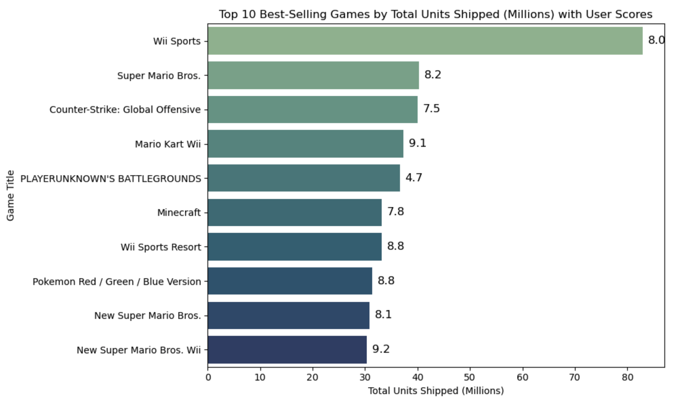
Best-Selling Games
Sales Insights
Wii Sports, Super Mario Bros., and CS:GO lead the charts in total units shipped worldwide.
User Score averages are annotated directly on the bars using Matplotlib text overlays for clarity.
This reveals that the best-selling games are not necessarily the highest-rated by users.
The visualization demonstrates effective integration of Seaborn for plotting and Matplotlib for enhanced labeling and annotation.

Slide 12
Conclusion
Conclusion
Seaborn offers a cleaner, faster workflow ideal for exploratory data analysis.
Matplotlib is helpful for fine-tuning visual elements like titles, legends, and annotations.
Visual storytelling is clearer and more consistent when combining Seaborn and Matplotlib.
Seaborn is optimal for analytics and data science requiring strong visual clarity and efficiency.

